Slide 1

EventCraft
Supervisor (Syed Farooq Zadi) Co-supervisor (Fahad Hussain)
20K-1038 Qazi Zain (Team Leader)
20K-1672 Zain Ul Abdin (Team Member)
19K-1066 Ali Kahful Wara (Team Member)

Slide 2
Contents
Problem Statement & Objectives (Recap)
Background of System
Work update & Progress
Contribution

Slide 3
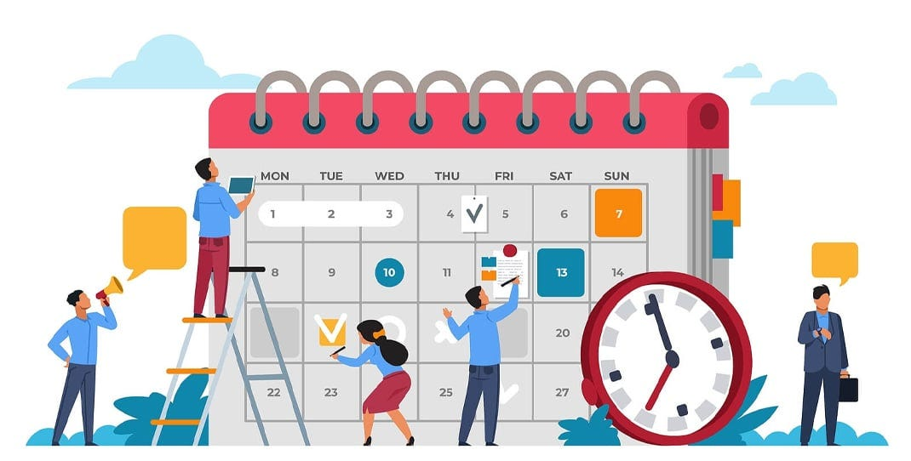
problem statement
The process of streamlining personal event planning for demographics by addressing logistical challenges, such as venue booking and service provider coordination to create good experiences within budget constraints.

Slide 4
background of system
To develop an HCI-powered event planning platform that reduces stress and planning time for individuals, according to previous survey the young professionals, by 50% were part of stress. This platform will achieve this by:
Automating tasks: Streamlining tedious processes like venue booking and vendor coordination.
Personalizing recommendations: Utilizing Recommended System to suggest user and Service Provider, manage budgets, and optimize event planning based on individual preferences.
Integrating with relevant services: Providing seamless connections with external services for booking, communication, and other event-related needs.

Slide 5
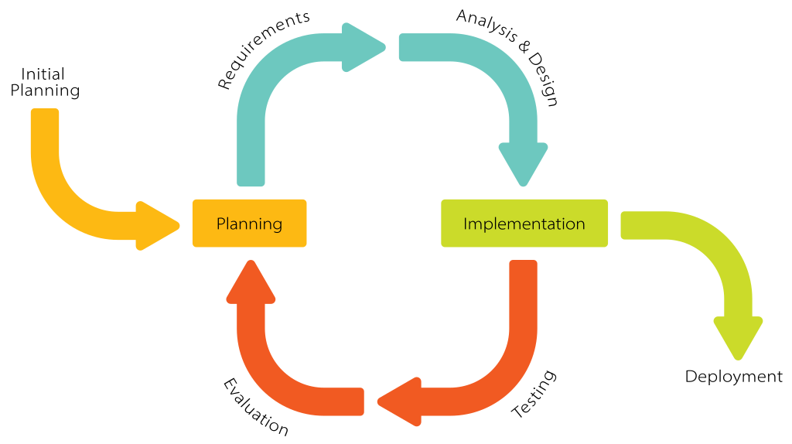
work-update & progress
As the project is more focused over the HCI and Event Planning strategies throughout the project we are following the below techniques:
Software Architecture: SDLC (Iterative & Incremental) approach

Slide 6
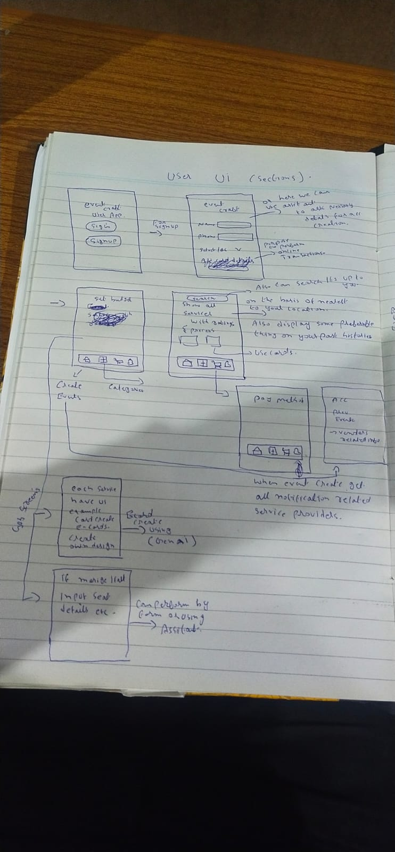
work-update & progress
Design Analysis of UI
USER UI

Slide 7
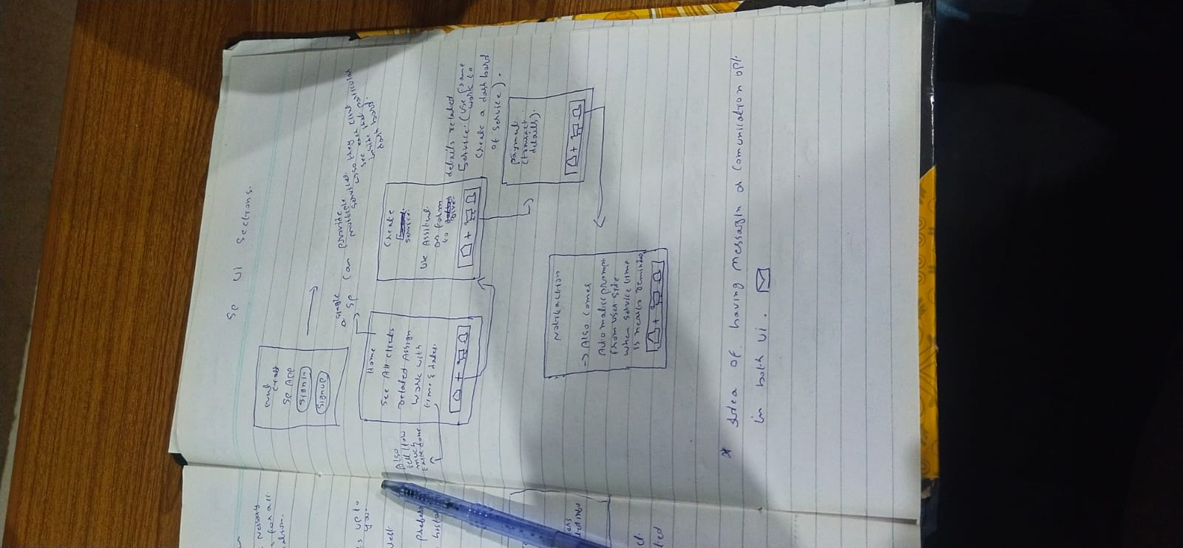
work-update & progress
Design Analysis of UI
SERVICE_PROVIDER UI

Slide 8
work-update & progress
Links Figma Designs https://www.figma.com/design/ADsa8W34H88ChZYwIJ11x4/Untitled?node-id=0-1&t=JQPVJEyibDaNoRzQ-0 Github Resources https://github.com/MirzaZain110/FYP-1/tree/main

Slide 9
work-update & progress

Slide 10
contribution

Slide 11

Thank you

